Slide 1
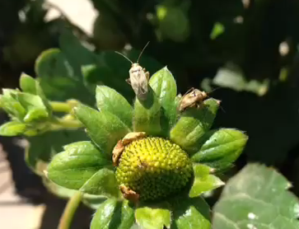

Lygus Bug Vacuum Program
Hillary Q. Thomas, PhD
California Strawberry Commission

Slide 2
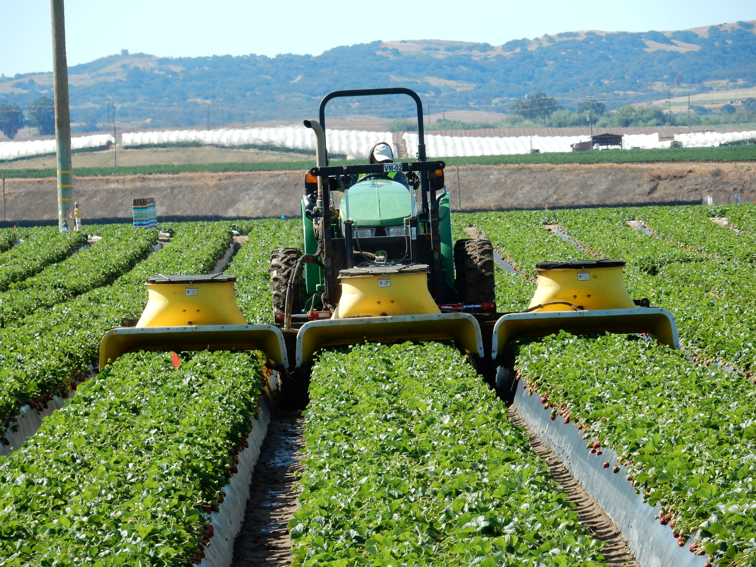
Why bug vacuums?

Slide 3
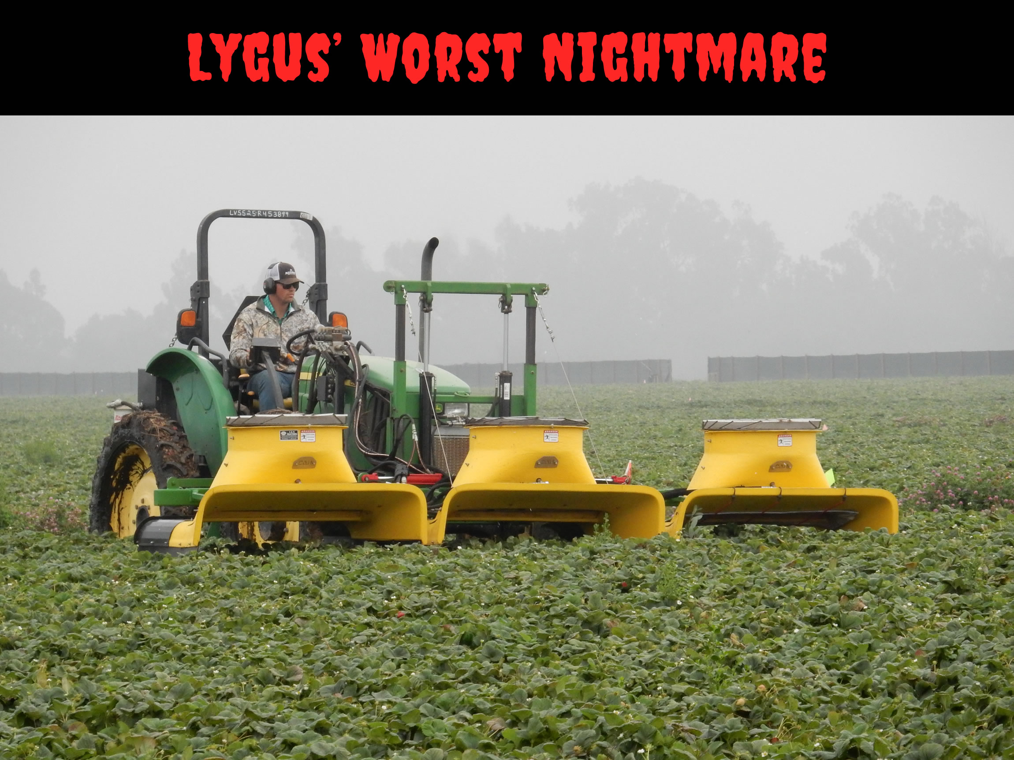
40% avg reduction in population
25 % increase marketable fruit

Slide 4
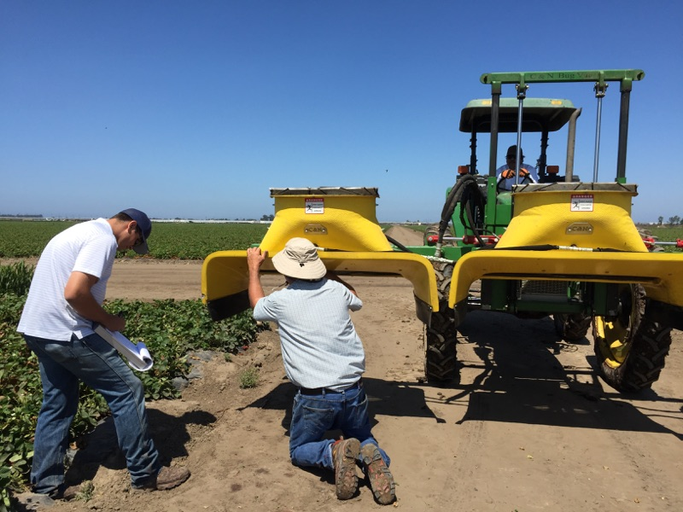
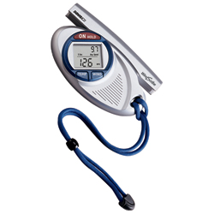
Vacuum efficiency assessments

Slide 5
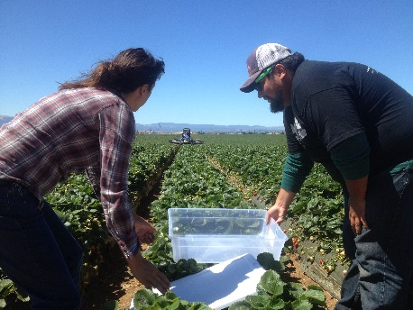
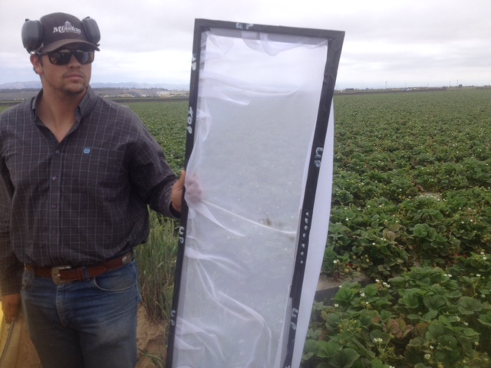
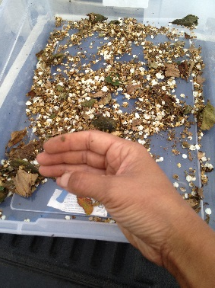
Methods
Beat sampling
Sampling at the intake
Sampling at the baffle/exit

Slide 6
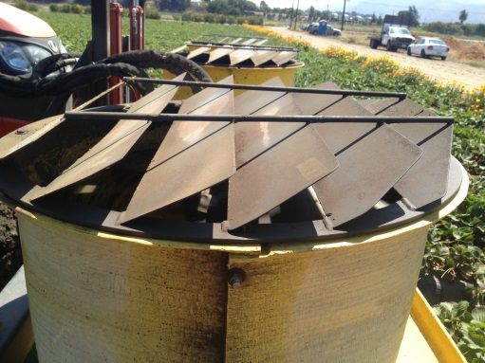
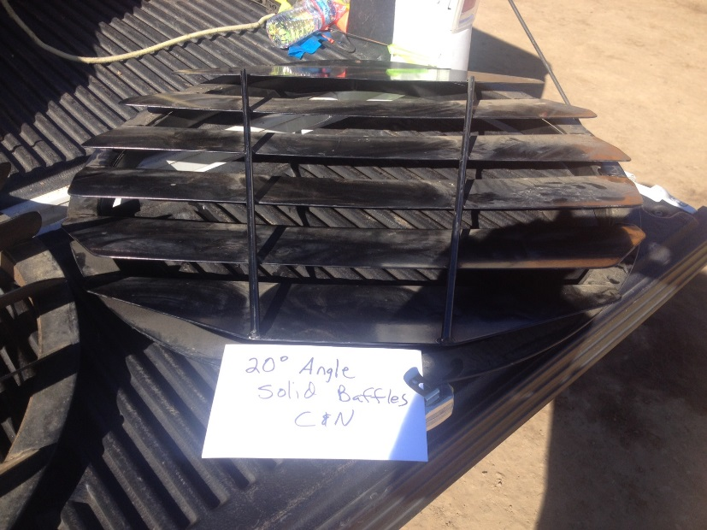
Vacuum Efficiency
  Grower Standard, 45° louvers 42.43 mph:
          Avg 2.5 % efficiency
Survival after vacuum:
    11.67% large nymphs
    22.85% adults survive
20° degree louvers increase kill, decrease windspeed at intake to 27 mph

Slide 7
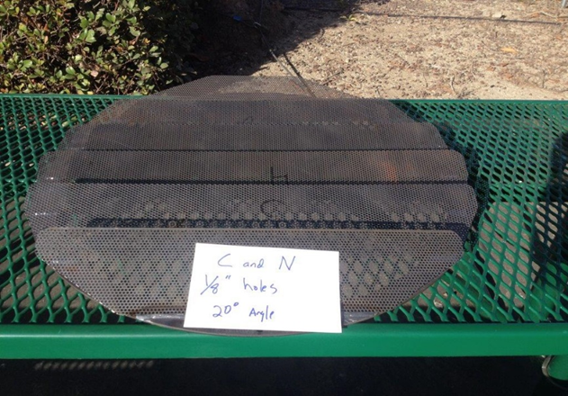
Baffle Modifications
20 degree louvers
with 1/8” holes
46.94 mph
100% kill of uptake
4.18% efficiency
Goal: 25%!!

Slide 8
Emerging findings…
New design and motors with 3000 psi rating
  Pick up 2x as many Lygus as industry standard (one experiment)
Moisture is a factor
  Time of day?

Slide 9
  Efficiency doesn’t drop off quickly
  Low Population Density
  High Population Density
  Small nymphs are 45-57%

Slide 10
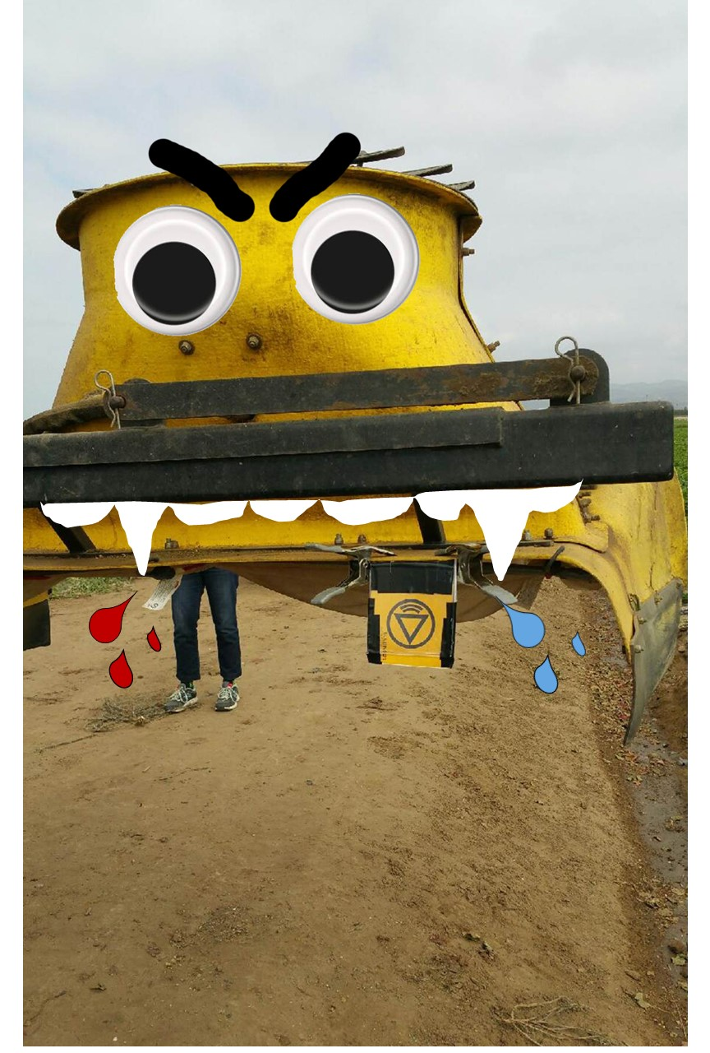
Recommendations
Regularly test and maximize windspeed
  Up P.S.I. from 2000 to 2500 ups speed by ~5 mph
  Modify baffles
Use baffles with angle lower than 45 degrees, with perforated louvers
Regularly scheduled maintenance on hydraulic
Train drivers to:
  Drive 2 mph
  Operate at canopy

Slide 11
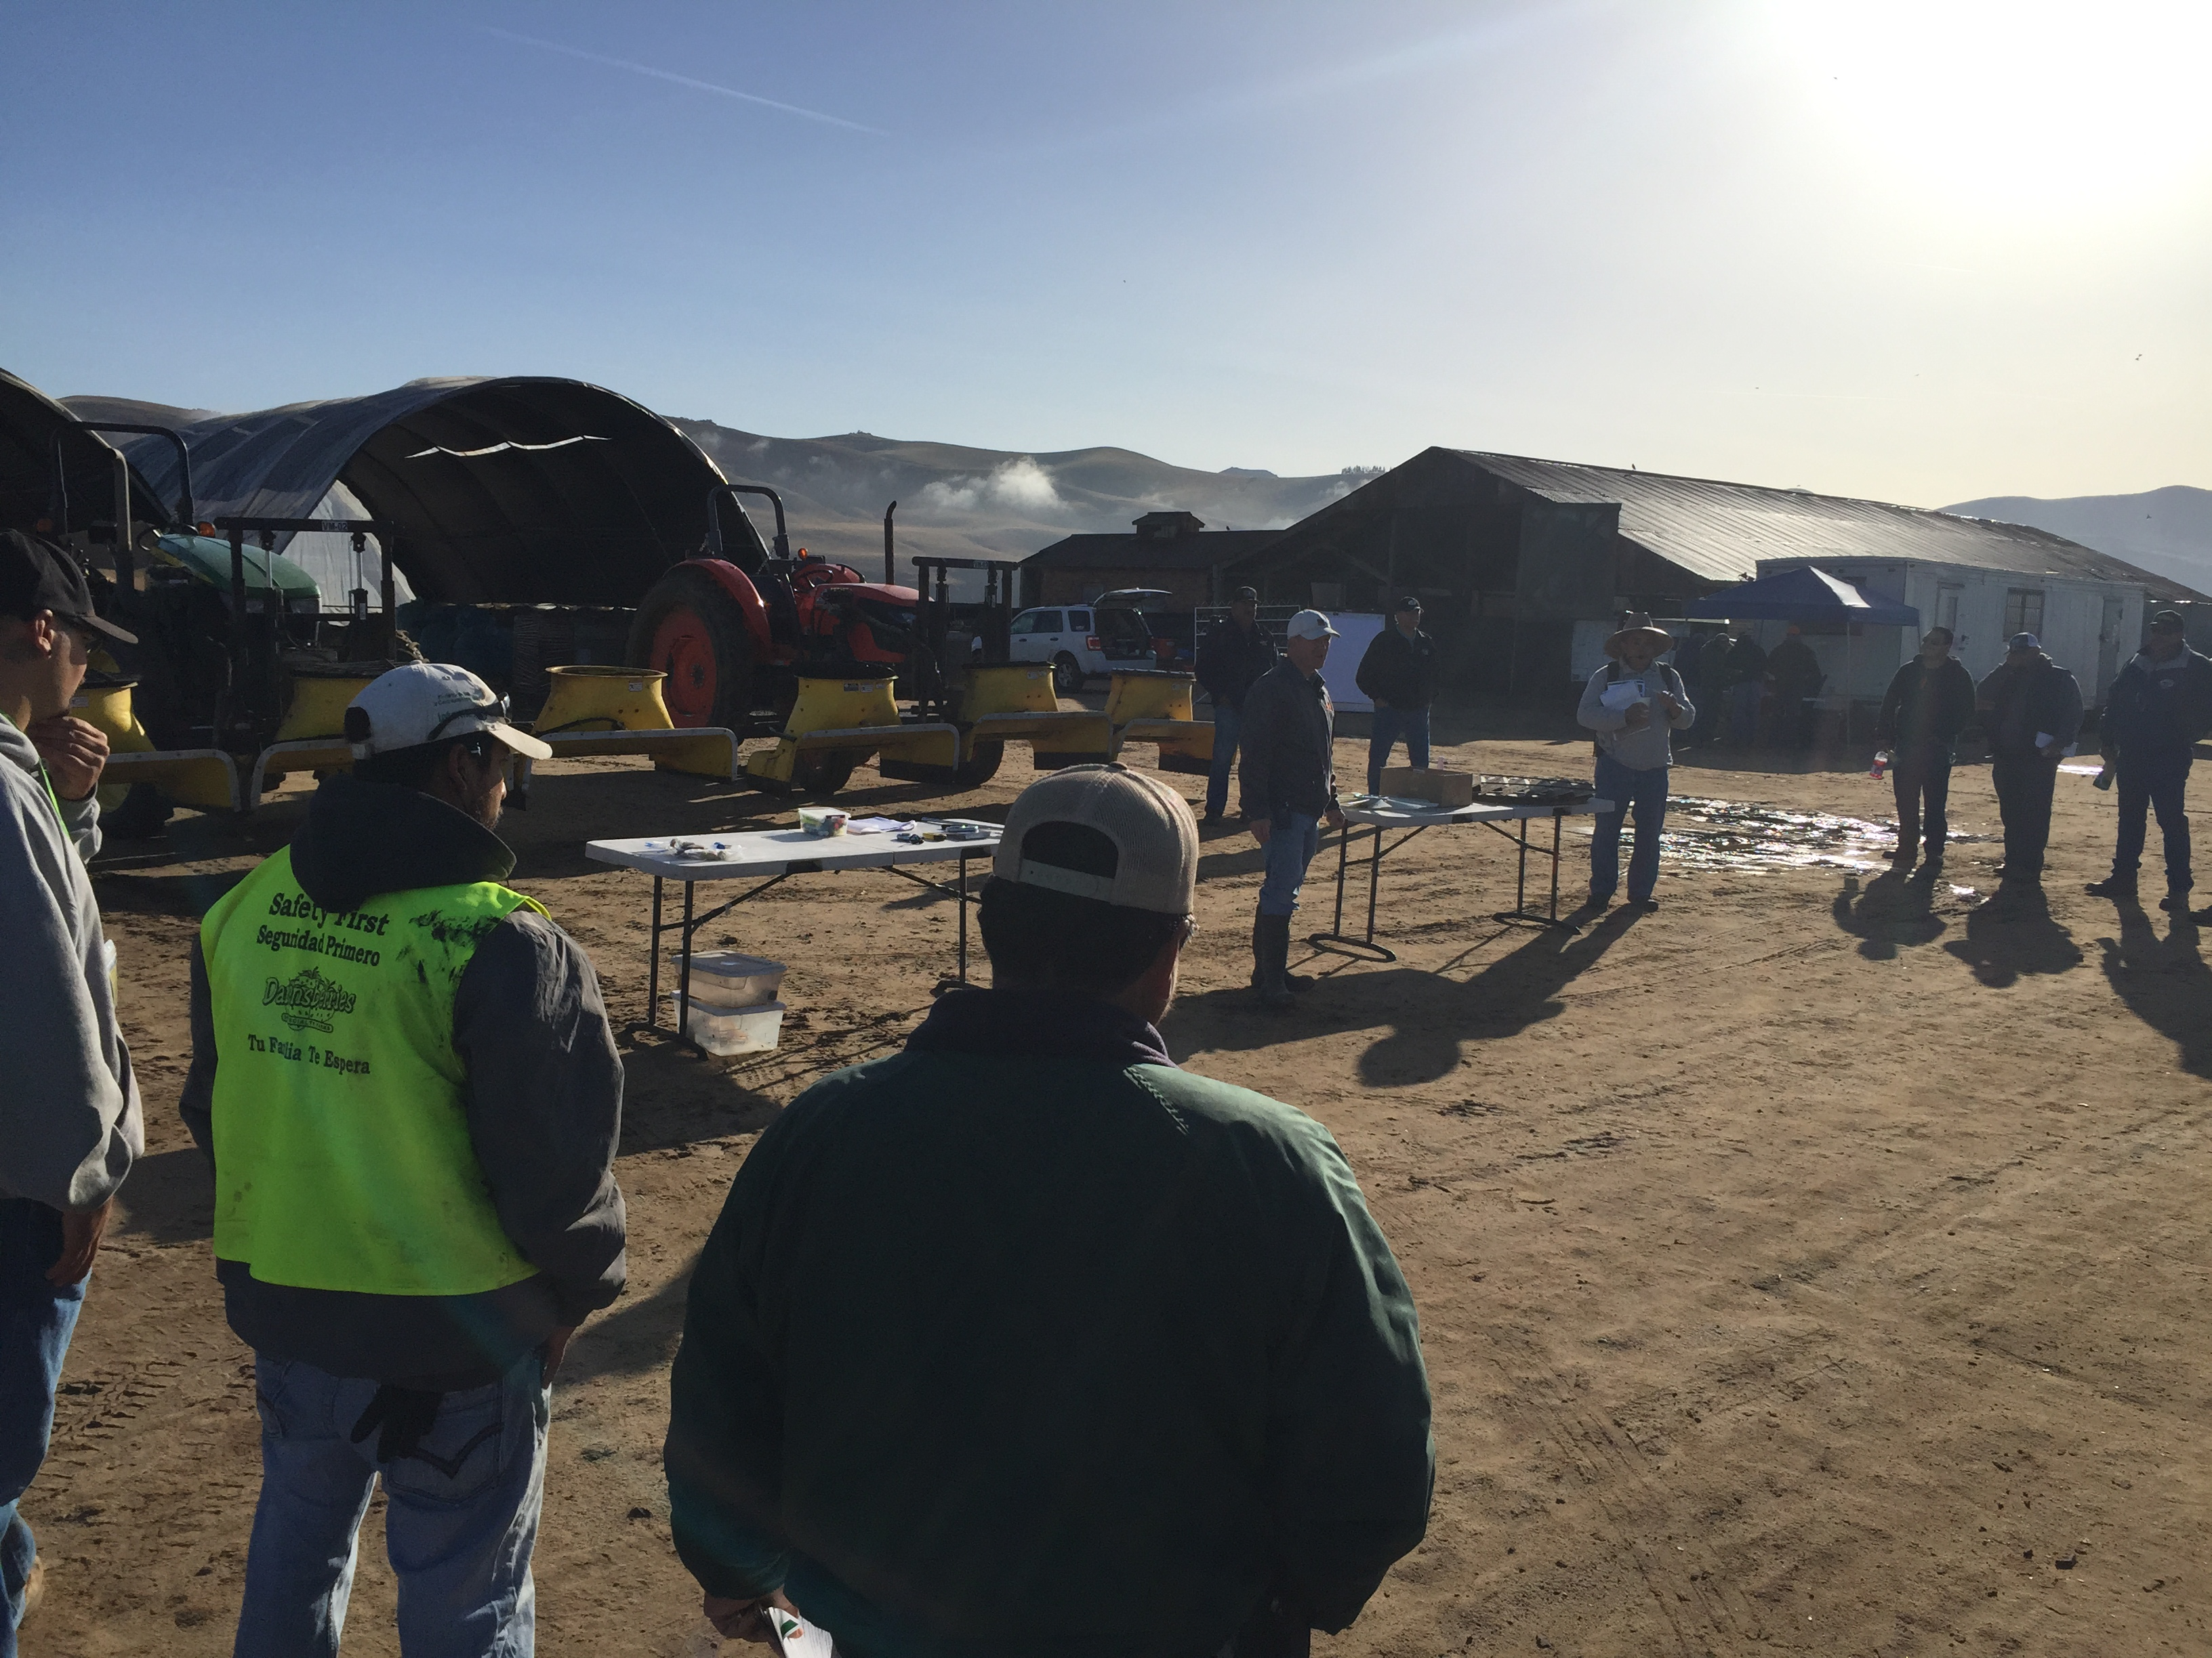
Bug Vacuum Trainings
CSC designed and rolled out trainings last spring
Materials available in English and Spanish
More trainings to come - Spring, 2016

Slide 12
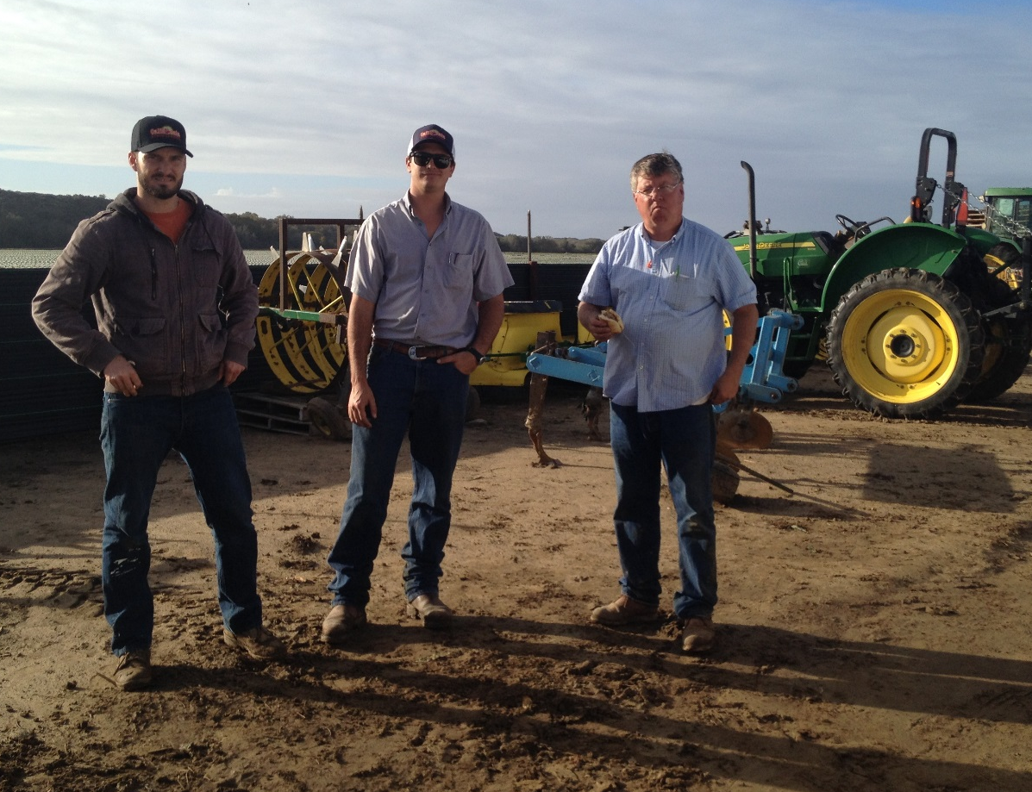
Acknowledgments
Dan Legard
Mark Edsall*
Daniel Olivier
Sundance Farms
Mar Vista
Anonymous grower collaborators
Interns
Myles Shoemaker*
Joseph Ugalde
Jose Valdez
Jimmy Wells
Vanessa Castillo
Kyle Blauer
Ryan Brantley
Martin Morones
Questions? hthomas@calstrawberry.org

