Slide 1
Fumigation Updates
Presented by:
Blanca Enriquez-Pratt
Supervising Agricultural Inspector Biologist

Slide 2
Chloropicrin
No more Methyl Bromide (MeBr) – as of January 1, 2017
Time Restrictions: Non-TIF and untarped fumigations shall start no earlier than ONE hour AFTER sunrise, and shall end no earlier than THREE hours prior to sunset.
Micro Sprinklers can MEET the requirements of “sprinklers in place” as long as the tarp used is on the APPROVED county TIF Tarp list.

Slide 3
County approved TIF Tarps for Chloropicrin 60% Buffer Zone reduction
The following tarps are approved for use with field soil fumigants containing chloropicrin and qualify for a 60% buffer zone reduction credit. This list is the same as DPR's newly released list. Note some of the tarps from our previous list no longer qualify. The mil listed for tarp thickness is the minimum allowed. All colors for each tarp are included.
AEP Sunfilm UltraShield,-EVOH-barrier, 1.0 mil
AgroSIF 015 Super Impermeable Film, EVOH barrier, 1.0 mil
Berry Plastics Total Blockade TIF, 1.25 mil
Filmtech Grozone MAX TIF, 1.25 mil
Ginegar Ozgard T Plus, 1.5 mil, TIF
Guardian TIF, > 1.1 mil
Imaflex USA Can-Block Clear v-TIF XSB, 0.9 mil
Next Generation TIF DN Mulch, 1.25 mil
Plainnova UBF Ultra100, > 1.0 mil (MIF Maximum Impermeable Film)
Raven TIF VaporSafeTM, > 1 mil
TRM Manufacturing Weather-all Power Film HB 125, > 1.25 mil

Slide 4
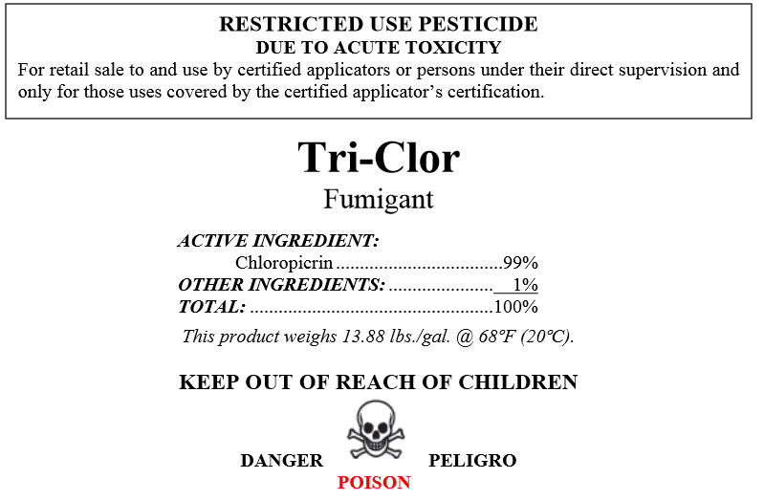
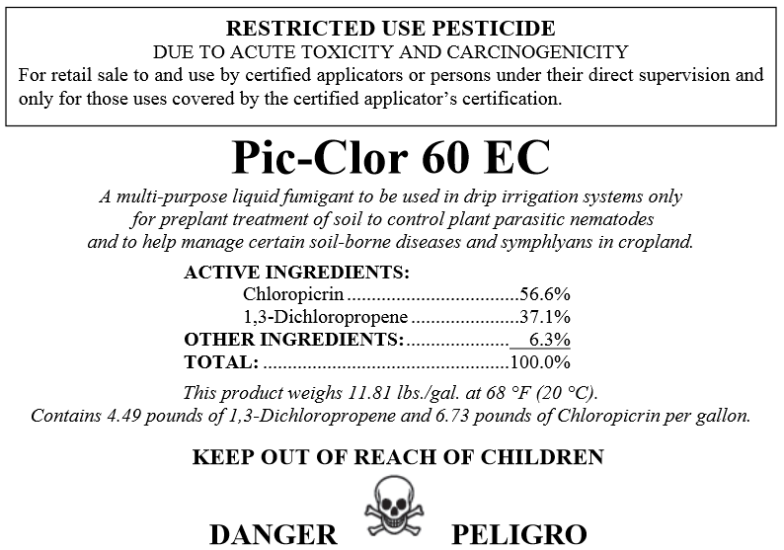
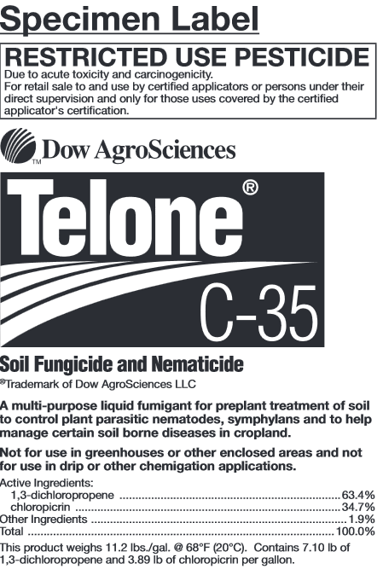
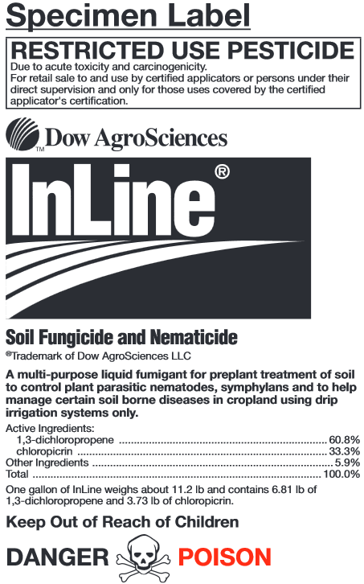
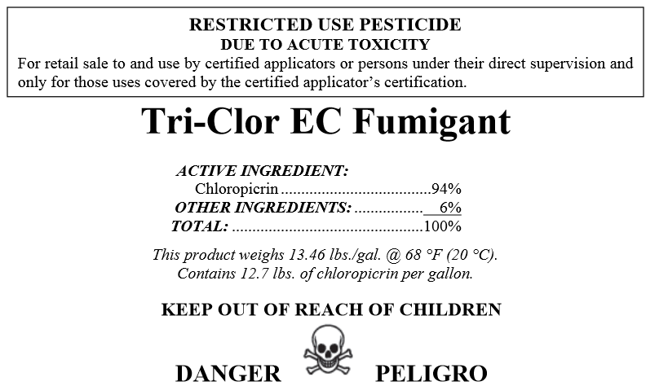
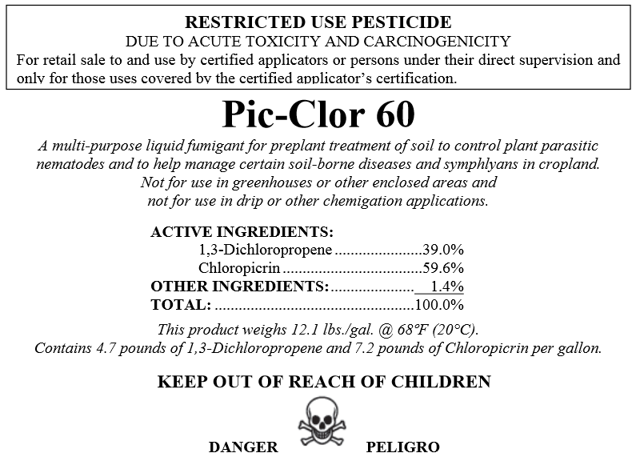
How to determine Buffer Zone (BZ) for Chloropicrin
Label:
Ventura County Restricted Materials Permit Field Fumigation Conditions
Appendix K:
www.cdpr.ca.gov/docs/enforce/compend/vol_3/append_k.pdf
Use the MOST RESTRICTIVE Buffer Zone Distance

Slide 5
Chloropicrin Minimum Buffer Zone Distances:
Tarps that qualify for a reduction credit of 60% | Tarps that do not qualify for a reduction credit of 60% |  | Untarped applications
 | Application block Less than or equal to 6 acres | Application block Greater than 6 acres, up to 40 acres
25 feet | 60 feet | 100 feet | 100 feet

Slide 6
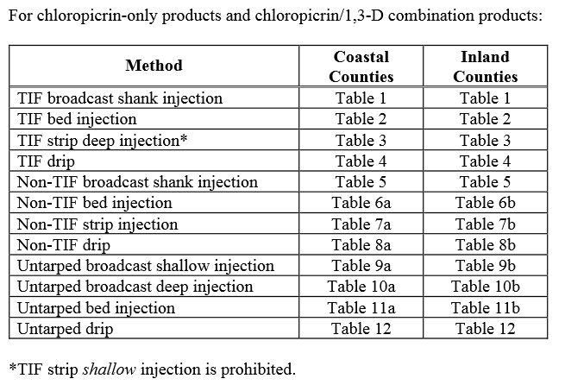
Appendix K
www.cdpr.ca.gov/docs/enforce/compend/vol_3/append_k.pdf

Slide 7
Notice of Intent for Fumigations
AT LEAST 3 BUSINESS DAYS prior to the start of the fumigation
Example:
Job for Monday – must be submitted prior to WEDNESDAY 9:00am (previous week)
Job for Tuesday – must be submitted prior to THURSDAY 9:00am (previous week)
Job for Wednesday – must be submitted prior to FRIDAY 9:00am (previous week)
Job for Thursday – must be submitted prior to MONDAY 9:00am (current week)
Job for Friday – must be submitted prior to TUESDAY 9:00am (current week)
Job for Saturday – must be submitted prior to WEDNESDAY 9:00am (current week)
Job for Sunday – must be submitted prior to WEDNESDAY 9:00am (previous week)
Must receive APPROVAL PRIOR to start of application
If the fumigation does not begin within 12 hours of the scheduled start time, a new NOI must be submitted and approved

Slide 8
1,3-Dichloropropene (1,3-D) Township and Range Monitoring
1N21W
2N21W
2N22W
Theses Township and Range sections historically deplete the allotted bank each year

Slide 9
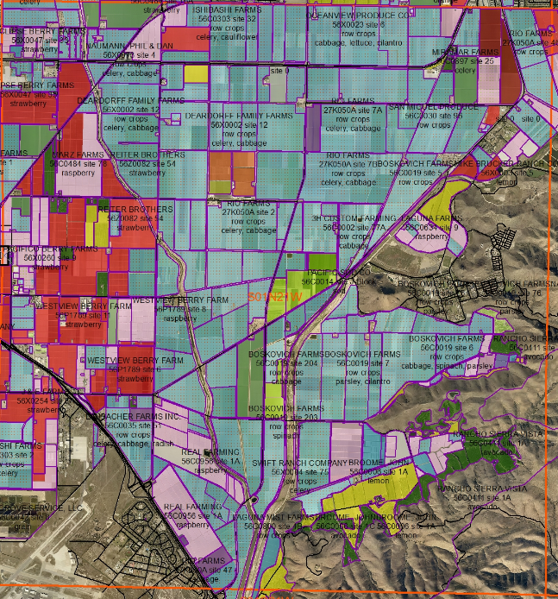
1,3-D Township and Range
Monitoring
S01N21W
Adjusted total pounds (ATP) allowed: 136,000 pounds in each township for each year.
All applications of 1,3-D are prohibited in December.

Slide 10
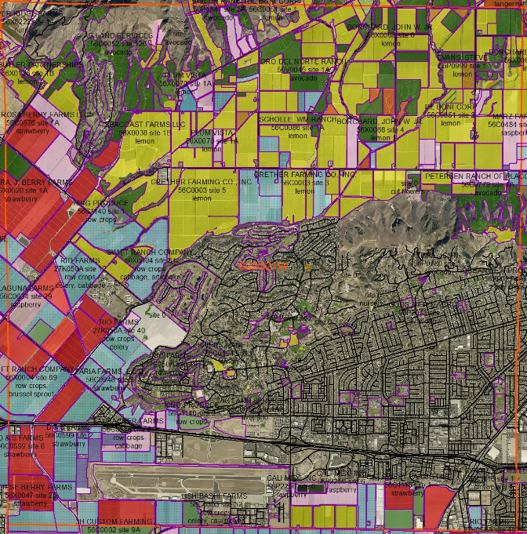
1,3-D Township and Range
Monitoring
S02N21W
Adjusted total pounds (ATP) allowed: 136,000 pounds in each township for each year.
All applications of 1,3-D are prohibited in December.

Slide 11
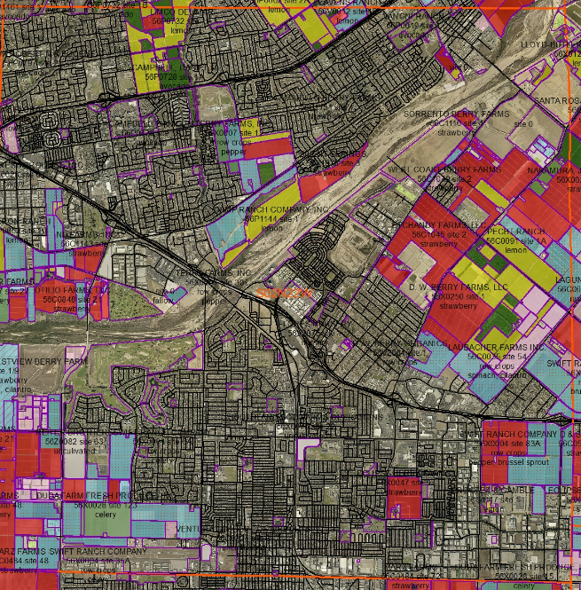
1,3-D Township and Range
Monitoring
S02N22W
Adjusted total pounds (ATP) allowed: 136,000 pounds in each township for each year.
All applications of 1,3-D are prohibited in December.

Slide 12
1,3-D
Follow additional conditions until final conditions are adopted by the county:
Appendix J
http://www.cdpr.ca.gov/docs/enforce/compend/vol_3/append_j.pdf

Slide 13
Metam Sodium and Metam Potassium
Drip applications must start no earlier than ONE hour after sunrise and must be completed no later than ONE hour before sunset.
Metam Sodium drip applications minimum buffer zone is 100 feet.
Metam Potassium drip applications minimum buffer zone is 90 feet.
Application site monitoring as described in this permit condition is SEPARATE from the “Fumigant Site Monitoring” option of the “Emergency Preparedness and Response Measures” specified on the label, and must be conducted for each application.
Pre Application
During Application
Post Application

Slide 14
RESUBMITTALS
Reasons to Resubmit:
Date Change
Acreage Change
Schedule Change
Permission/Vacating Agreement could not be obtained by start date
24 HOURS is REQUIRED for ALL Resubmittals
Resubmittals must be a “clean” copy (without written conditions added)

Slide 15
Fumigation Forms and Conditions are ALL being UPDATED:
Fumigant Permissions
Fumigant Vacating Agreement
Specific Fumigant Conditions
Ventura County Field Fumigation Conditions

Slide 16
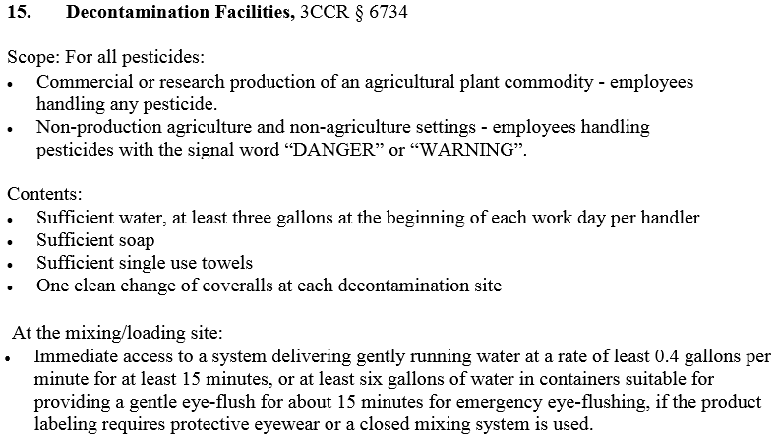
Decontamination Facilities Update

Slide 17
Application Exclusion Zone
"Application exclusion zone" (AEZ) means the area surrounding the application equipment (“halo”) that must be free of all persons other than appropriately trained and equipped handlers during pesticide applications. The AEZ moves with the application equipment.
No employer shall direct or allow any person, other than the persons making the application, to enter or remain in the AEZ and corresponding treated field during the application.
The area that extends 100 feet horizontally from the application equipment in all directions during application when the pesticide is applied by any of the following methods: aerially; air blast; as a fumigant, smoke, mist, or fog; or as a fine spray.
The area that extends 25 feet horizontally from the application equipment in all directions during application when the pesticide is applied in a manner not specified in (a) and is sprayed from a height of greater than 12 inches from the soil or planting medium using at least a medium spray.

Slide 18
Application Exclusion Zone
Site
AEZ
Application
Treated Area

Slide 20
Questions?

Slide 21
Contact Information:
Blanca Enriquez-Pratt
Supervising Agricultural Inspector Biologist
Ventura County Agricultural Commissioner’s Office
555 Airport Way Suite I
Camarillo, Ca. 93010
Office: (805) 388-4222

